Slide 1

INTELI-REHAB
A Smart Wearable Rehabilitation System
Tehreem Zaheer Sp23-BCS-131
Kashmala Zeb Sp23-BSE-048
Ahmed Irshad Sp23-BSE-045
Supervisor: Dr Ahmad Khan
Department of Computer Science
COMSATS University Islamabad, Abbottabad Campus

Slide 2
Agenda of the Presentation
Motivation
Brief Introduction
Scope (What to do and What not to do)
Functionalities
Proposed Tools/Platform
Feasibility (Technical, Financial, Resource, Operational)
Schedule (Gantt Chart)
Tasks for 1st Iteration
Conclusion

Slide 3
Motivation
Paper-based home exercises with no supervision
Incorrect movements lead to slow recovery or re-injury
Physiotherapists lack real-time patient progress data
Recovery depends on subjective patient feedback
Repetitive exercises reduce patient motivation
Patients often quit before full rehabilitation
Wearable sensors enable real-time motion tracking

Slide 4
Motivation (cont’d)
AI can detect incorrect posture and movements
3D visualization improves exercise understanding
Gamification increases engagement and consistency
Smart rehabilitation brings clinic-level guidance to home

Slide 5
Brief Introduction
A smart rehabilitation platform for shoulder, elbow, and upper-arm recovery that combines wearable IMU and EMG sensors, AI-based movement analysis, and a mobile app to provide real-time physiotherapy support at home. The system tracks arm movement and muscle activity, visualizes exercises through a 3D digital twin, detects incorrect movements, and provides instant voice and visual feedback (preferably in Urdu). It also enables remote physiotherapist monitoring and uses gamification to improve patient engagement and recovery outcomes.

Slide 6
Scope (What the System Will Do)
Integration of dual IMU (Inertial Measurement Unit) sensors and dual-channel EMG (Electromyography) sensors for upper-limb rehabilitation monitoring.
Development of a BLE-enabled wearable system for real-time transmission of motion and muscle activity data to a mobile application.
Development of a Flutter-based Android mobile application for rehabilitation exercises, patient interaction, and physiotherapist connectivity.
Real-time acquisition and preprocessing of IMU and EMG sensor data, including filtering and normalization.

Slide 7
Scope (What the System Will Do) (cont’d)
Implementation of sensor fusion techniques for accurate arm orientation, motion tracking, and joint movement estimation.
EMG signal processing for monitoring muscle activation and rehabilitation performance.
Development of a 3D digital twin for real-time visualization of upper-limb movement and muscle activity.
AI-based anomaly detection for identifying incorrect posture, compensatory movements, and abnormal rehabilitation patterns.

Slide 8
Scope (What the System Will Do) (cont’d)
Real-time voice and visual feedback for exercise correction and guidance.
Personalized rehabilitation exercise management for physiotherapists and patients.
Development of a web-based clinic panel for adding appointed physiotherapist and web-based physiotherapist dashboard for remote monitoring, patient progress tracking, and rehabilitation analytics.
Automated repetition counting, Range of Motion (ROM) estimation, and exercise quality assessment using sensor data.
Gamification features including streaks, badges, milestones, and recovery levels to improve patient motivation and adherence.

Slide 9
Scope (What the System Will Do) (cont’d)
Cloud-based storage and synchronization of rehabilitation sessions and patient progress records.
Support for rehabilitation exercises targeting shoulder, elbow, and upper-arm musculoskeletal injuries.

Slide 10
Scope (What the System Will Not Do) (cont’d)
Upper-arm injuries only
Live video-based pose estimation systems
Clinical diagnostic capabilities beyond exercise guidance
Integration with hospital electronic medical record (EMR) systems
Physics-based biomechanical force simulations
Medical prescriptions or replacement of professional clinical diagnosis

Slide 11
Functionalities
Clinic and Patient Onboarding
FR01: The system shall allow patient registration and login under a appointed physiotherapist from selected hospital or clinic
FR02: The system shall permit physiotherapist login with role-based access to patient management tools
FR03: The system shall capture patient injury type, affected joint, and recovery stage during registration

Slide 12
Functionalities (cont’d)
Clinical Exercise Database
FR04: The system shall store rehabilitation exercise templates with target joint movement and muscle activation information
FR05: The system shall enable physiotherapist creation and assignment of personalized exercise protocols from exercise database
FR06: The system shall maintain version history for all protocol changes and assignments
FR07: The system shall support exercise scheduling with repetitions, sets, duration, and recovery intervals.

Slide 13
Functionalities (cont’d)
Wearable Sensor and Bluetooth Connection
FR08: The system shall establish Bluetooth Low Energy pairing between wearable and mobile application
FR09: The system shall stream dual IMU data (accelerometer, gyroscope) and dual EMG data from surface electrodes in real time
FR10 The system shall monitor Bluetooth connection quality and triggers automatic reconnection on dropout
FR11: The system shall support exercise scheduling with repetitions, sets, duration, and recovery intervals.

Slide 14
Functionalities (cont’d)
Biometric Baseline Establishment
FR12:The system shall guide patient through structured calibration sequence for neutral joint positions
FR13: The system shall record resting EMG baselines for each monitored upper-arm muscle
FR14: The system shall preprocess IMU and EMG signals using filtering and normalization techniques.
FR15: The system shall combine sensor data to estimate upper-limb orientation, movement trajectory, and joint angles.

Slide 15
Functionalities (cont’d)
Movement Tracking and Progress Measurement
FR16: The system shall track shoulder and elbow joint movements in real time.
FR17: The system shall process and convert sensor data into stable elbow joint angle for comparison against physiotherapist-prescribed target ranges
FR18: The system shall automatically count repetitions and detects rest intervals during exercise
FR19: The system shall estimate Range of Motion (ROM) progression throughout rehabilitation.
FR20: The system shall generate historical trend graphs showing ROM progression toward 100% goal

Slide 16
Functionalities (cont’d)
Live Digital Twin Visualization
FR21: The system shall render real-time 3D model of patient's upper arm (shoulder, upper arm, elbow)
FR22: The system shall display muscle activation via color palette: blue, green, orange, red
FR23: The system shall highlight incorrect posture or abnormal movement patterns using visual alerts.

Slide 17
Functionalities (cont’d)
Movement Quality Assessment and Corrective Alert System
FR24: The system shall detect abnormal movement patterns via an AI-based analyses
FR25: The system shall provide real-time visual feedback during rehabilitation exercises
FR26: The system shall provide real-time voice guidance and corrective alerts, preferably in Urdu.
FR27: The system shall log all anomaly and compensation events for physiotherapist dashboard review

Slide 18
Functionalities (cont’d)
Fatigue Monitoring and Safety Intervention
FR28: The system shall track muscle fatigue indicators against patient-specific calibration baselines
FR29: The system shall issue graded three-stage warnings: UI indicator, voice alert, session pause recommendation

Slide 19
Functionalities (cont’d)
Physiotherapist Control Center and Cloud Sync
FR30: The system shall have a web-based clinic panel limited to adding appointed physiotherapists
FR31: The system shall have a web-based physiotherapist dashboard showing patient adherence, performance, alerts, and ROM display on physiotherapist dashboard
FR32: The system shall allow prescription creation, modification, ROM target approval on the physiotherapist dashboard
FR33: The system shall issue alert notifications for concerning patterns

Slide 20
Proposed Tools/Platform
Category | Tools | For/Purpose
Frontend | Flutter | Mobile App development
Backend | Node.js And Express.js | API + logic
Databases | PostgreSQL via Supabase. | Structured + Cloud SQL database
Cloud | Supabase | Secure and Scalable
APIs / Testing | Postman | API docs + testing
Collaboration | GitHub | Version control
Design/Animation | Figma/Unity | UI/UX, Mockups/Animations

Slide 21
Feasibility
Technical Feasibility
Technology / Tool | Purpose | Feasibility
Flutter (Mobile) | Cross-platform mobile app development | Feasible, open-source
Node.js (Backend) | API development & server logic | Feasible, open-source
PostgreSQL | Relational database management | Reliable, widely used
Supabase | Backend-as-a-Service platform | Feasible
Git & GitHub | Version control & collaboration | Free, industry standard
Express.js | REST API framework | Fast, lightweight

Slide 22
Feasibility
Financial feasibility
Tools | Cost | For/Purpose
PyTorch (Open Source) | Free | AI model training and anomaly detection
Arduino IDE | Free | Sensor interfacing and embedded programming
PostgreSQL (Open Source) | Free | Relational database for data
ESP32 DevKit | Low Cost | Real-time sensor data acquisition and transmission
2 × MPU6050 | Low Cost | Upper arm and forearm motion tracking
2 × MyoWare 2.0 Muscle Sensor | Medium Cost | Biceps and triceps muscle activity acquisition
Public Datasets | Free | Model training and software development
Straps | Low Cost | Sensor attachment

Slide 23
Feasibility
Resource feasibility
Resource | Availability | Purpose
Development Team | Available | For Entire Project
Supervisor | Available | Evaluations and review
Laptops | Available | Development and testing environment
Smartphones | Available | Mobile app testing
Internet Connection | Available | Required for APIs, sync, GitHub

Slide 24
Feasibility
Operational feasibility
Ease of Use | Wearable IMU and EMG sensors with simple movement recording interface | Easy for patients, therapists, and researchers to operate
Accessibility | Portable system using lightweight sensors and laptop/mobile integration | Available to players everywhere with smartphones
Performance | Real-time elbow movement monitoring and abnormality detection using AI | Provides fast feedback during rehabilitation exercises
Maintenance | Modular sensor setup with open-source software tools | Easy to update models, recalibrate sensors, and replace components
Adoption Potential | AI-assisted rehabilitation improves exercise assessment accuracy | Encourages consistent and guided rehabilitation exercises

Slide 25
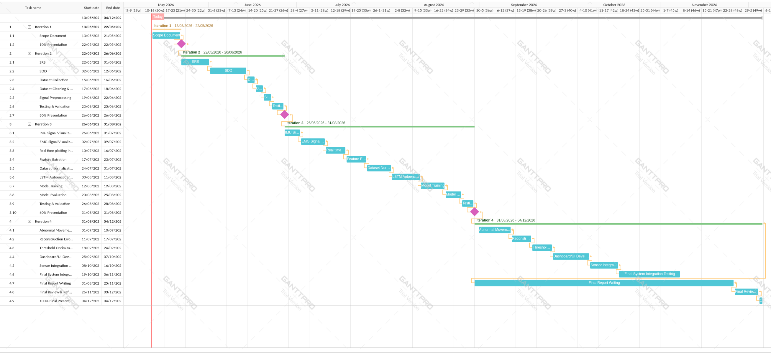
Schedule

Slide 26
Tasks for 1st Iteration (or 30%)
SRS
SDD
Frontend of Inteli-rehab mobile application
Wearable Hardware Prototype

Slide 27
Conclusion
AI-based system for detecting abnormal upper limb movements using IMU and EMG sensors.
Uses AI Model for anomaly detection in rehabilitation exercises.
Feasible using low-cost hardware and open-source tools.
Incremental model ensures systematic development and testing.
Useful for physiotherapy and rehabilitation monitoring.

